Slide 1
Assignment 1: Sequential Storyboard
For my interaction design, I would like to revisit my web-based data visualization platform. This ongoing project heavily incorporates an interactive GUI, allowing users to create graphs, widgets, and charts from datasets in CSV and Excel formats.
Currently, users upload a dataset and provide a description for context. The program then extracts the columns and prompts users to add labels and descriptions for each one. Finally, after clicking "Create," the system generates graph widgets and places them in a carousel.

Slide 2
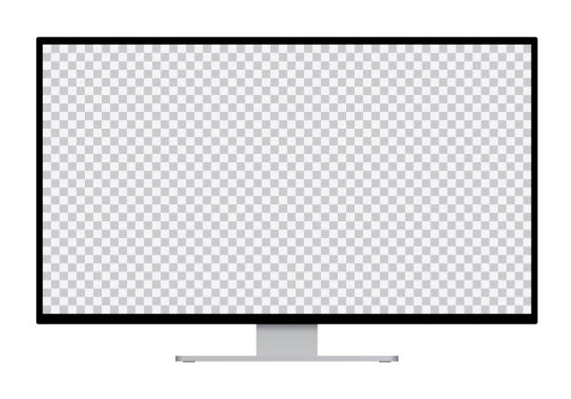
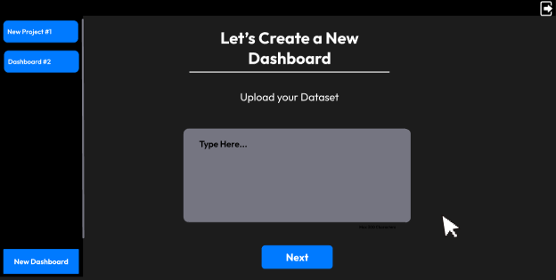
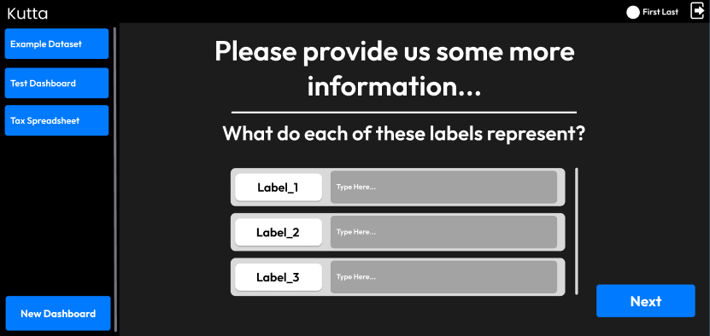
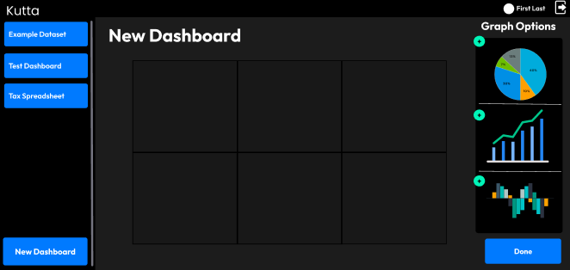
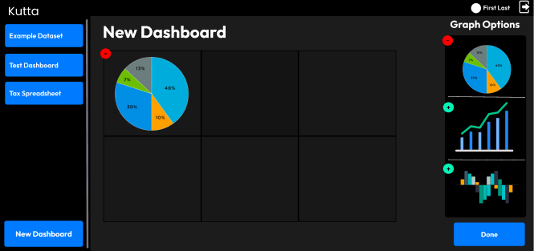
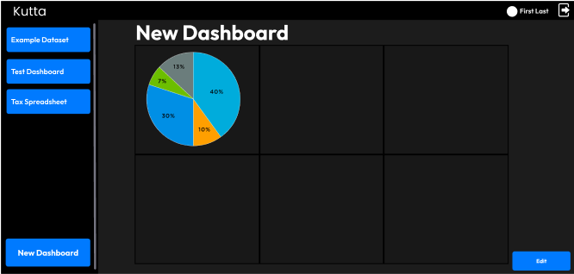
Current Dashboard-Creation Flow
User must provide information on the extracted columns
2
User uploads a Dataset in the form of a CSV. They then provide a description of the dataset in the text box.
User can now add Graph Widgets to their dashboard
Application creates graph and charts based on the dataset columns and data types. User is provided with the graphs.
User can now collapse widget carrousel and interact with graph widgets. Widget position and size are static.

Slide 3
Worksheet 2 – Interaction Flows
3
Current Dashboard In Flow:
Attach a CSV or Excel File
Describe the dataset and give prompt context
Give each column a description
Give each column a data type
Wait for Graphs and Charts to render
Add Graphs and Charts to Dashboard
Tedious
Many Steps involved
More User input needed than necessary
Solution – Remove the user input page
Allow the AI model to extract the column descriptions and column datatypes automatically (See Figma)
Current Widget Interactions:
Can only pin widget to a set, static grid box
Can not move around widget or resize the widget dynamically
Widgets cannot be altered, except a zoom in option
Tedious
User interaction is minimal and does not allow for more engaging visualization experience
Solution – Add interactive widgets, so resizing, dynamic placeholding, and flexible movement (See Figma)

